Slide 1
Self-driving
SMARTCAB

Slide 2
Overview
We are at an age when we have industry leaders like Audi, Mercedes-Benz, Tesla and others innovating in the autonomous vehicles space. With the steady growth in commercialization and the increasing affordability of this technology, this is no longer a niche for the enthusiasts.
We can surely expect that some time in the near future we will see more and more commercial vehicles move towards automation.
Our project is a simplistic demonstration of this very idea. Our aim, with this project, was to create a smart cab agent that starts at a point and drives to its destination in the allotted time, adhering to basic driving rules, improving over time armed with Reinforcement Learning.

Slide 3
Understanding the problems
01
The first step was to create a basic driving agent in a given environment. In our case we are using an environment created by udemy.
02
The next step was to inform the driving agent about the different states in the problem. In our case, we have states that factor in the next waypoint(Left, Right, Forward), traffic light(red or green) and incoming traffic(None, forward, left, right)
03
The final step was to improve our learning agent so that with the help of Q-learning it can select the optimal action at each location.

Slide 4
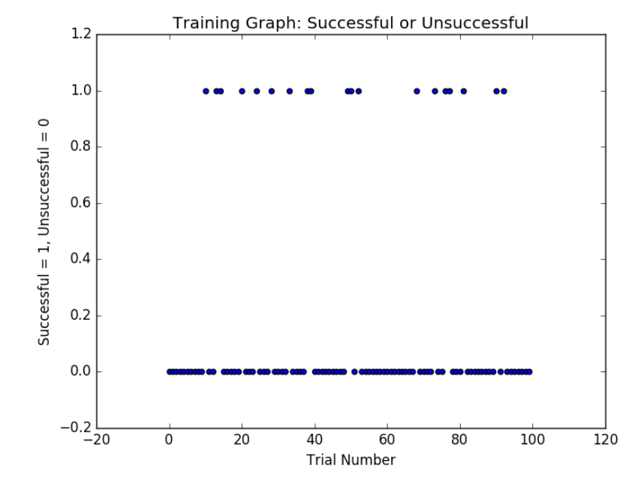
Basic Driving Agent
Our final agent takes into account it’s waypoint, the traffic signals and incoming traffic to select it’s next action.
However, for our basic driving agent, we just wanted to make sure that it chooses any random action so that we could establish a basepoint.
random_action = random.SystemRandom()
return random_action.choice(self.valid_actions)

Slide 5
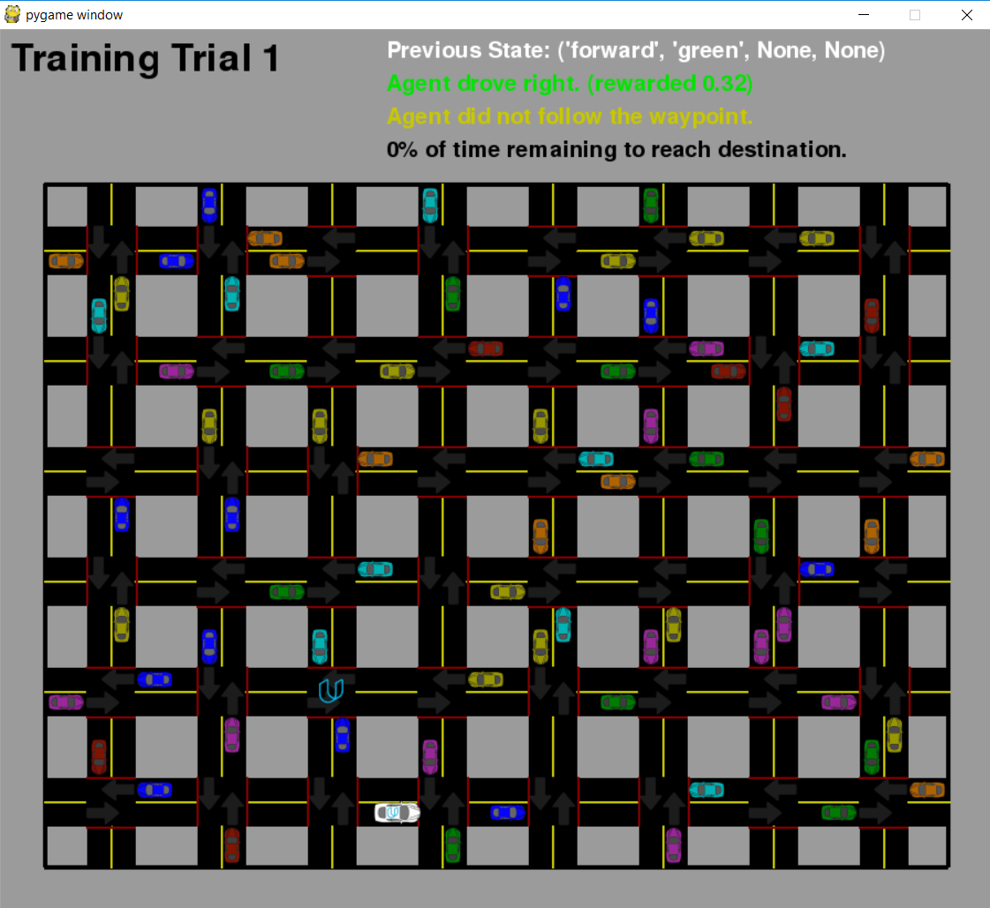
Trials and Simulation
Our program runs multiple trials and over time learns to take better actions by taking the rewards during those trials to optimize its approach during the final simulation runs.
For this we are running 1000+ trials and 100 simulations for a well-spread dataset.

Slide 6
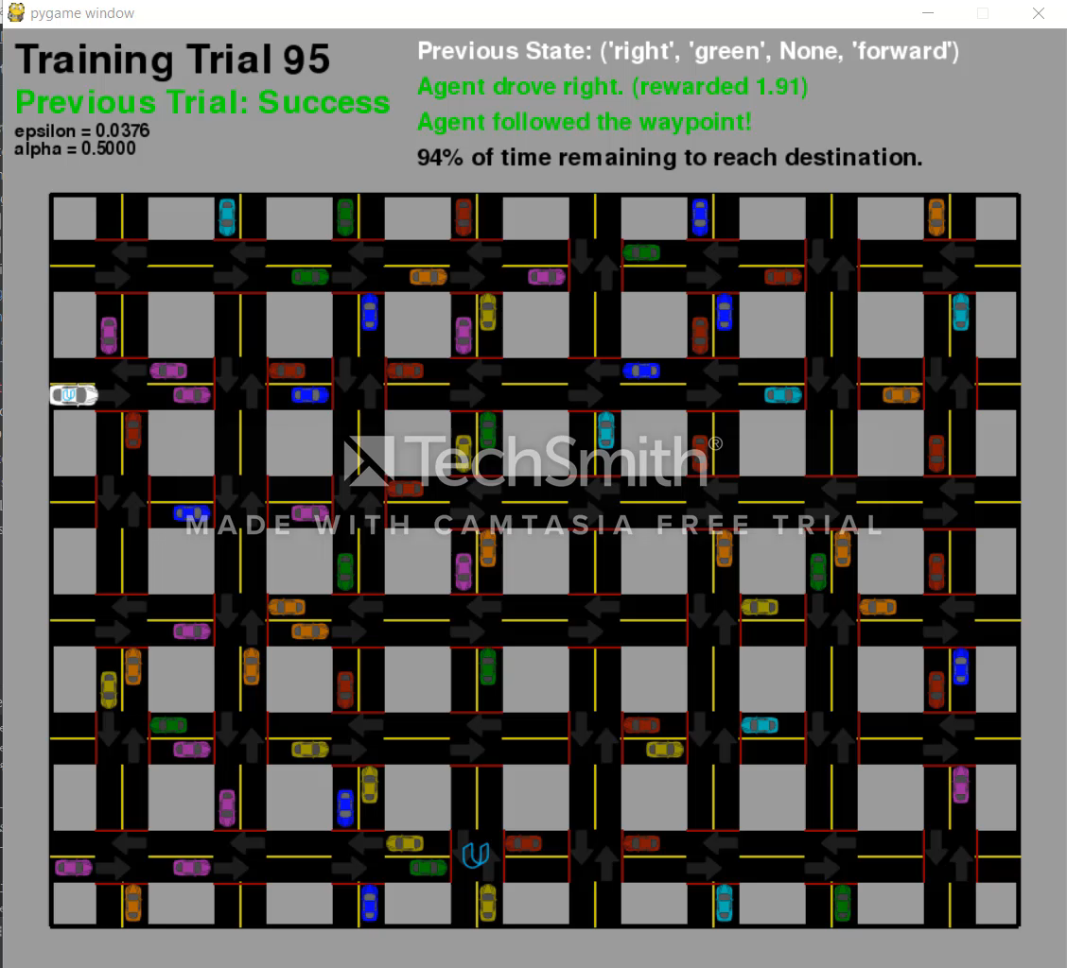
Trials and Simulation

Slide 7
Informed Agent
Here we simulated a Q Learning agent which takes into account the different variables that are present at each point (namely traffic, signals and waypoint).
For the Q-learning formula we initiated the following parameters to start off with.
Alpha (learning rate), is arbitrarily set at 0.4.
Epsilon is arbitrarily set at 1.
Even with this arbitrary value selection we achieved a 87% success rate.

Slide 8
Improving the learning
The next and final step was to improve the learning of the agent.
Till now with the arbitrary values to the Q-Learning algorithm taken initially, we achieved a 87% success during the simulations. We experimented with multiple different sets of values to these parameters(alpha and epsilon) and arrived at the values that seem to be performing the best during the simulations.
The values that gave us the best results were :
Alpha (learning rate): 0.5
Epsilon: We are using a cosine function to decay the epsilon over time with trials.

Slide 9
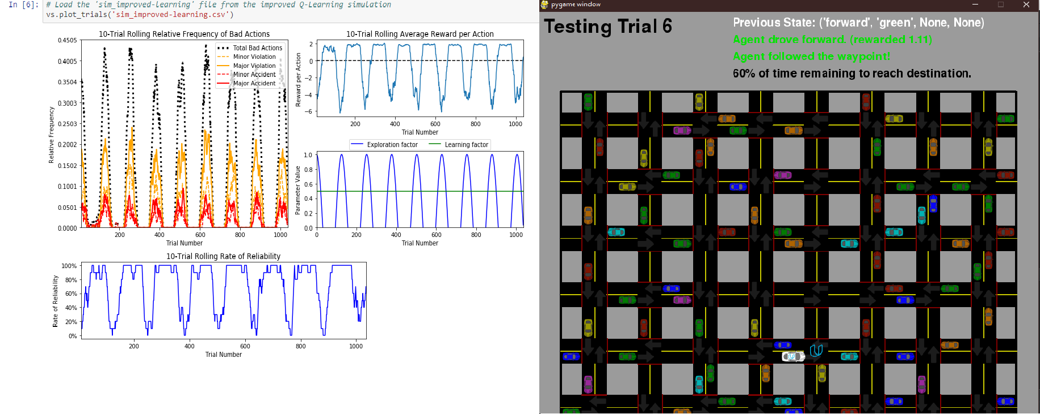
Safety and reliability

Slide 10
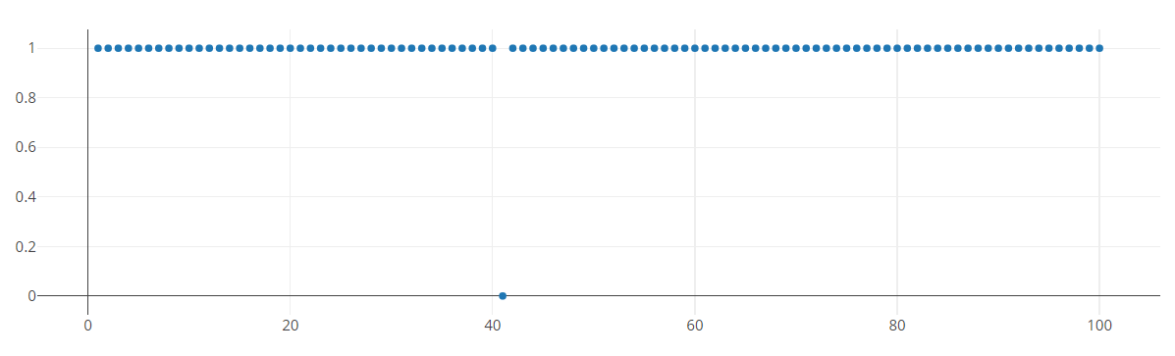
Success Rate
With our new values, we managed to reach a success rate of 99%, which means that in 100 simulation runs only once the agent was unable to reach his destination in time while following all the traffic rules, waypoints and oncoming traffic.

Slide 11
PRESENTED BY:
Parthasarathi Mitra
Karan Singh

